Slide 1
Southern Water Corp – Non-Technical Presentation
Date: 5/21/2020
Presenter: Derick Lai

Slide 2
Southern Water Corp has been experiencing issues with their Surjek Desalination Plants due to increased demand from agricultural and residential usage. This in turn has led to production issues in regards to Plant Maintenance
!
Southern Water Corp has had to increase production to meet it’s clients increased demand.
Revenues have increased for the Calendar year but production costs have increased.
!
Increased production has also put more stress on equipment necessary to produce water supply.
Increased production has led to mechanical issues for water production pumps. Maintenance schedule needs to be re-evaluated.
!
Increase Forecast Revenues and potentially higher maintenance costs are key concerns.
Will need to effectively look at where higher costs are of concern and to identify key problem indicators for production equipment.

Slide 3
Production costs are forecasted to rise significantly beginning in November and peak at April. Notice the individual plant breakdowns below the Overall figure. Kootha and Surjek show the most increase in Forecasted costs.

Slide 4
When weighed against the Market Price, Jutik has shown to be the most cost efficient. Surjek cost of production significantly outweigh the other plants.
Pseudo Cost Curve Highlighting Cost to Produce versus Market Price
Weighted Market Price
53.98 M/L
Least Expensive
Most Expensive
Source: Southern Water Corp Financial Records (SAP) 2013-2015
Source: Open Water Market Data (2013 – 2015)

Slide 5
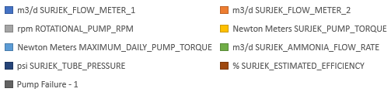
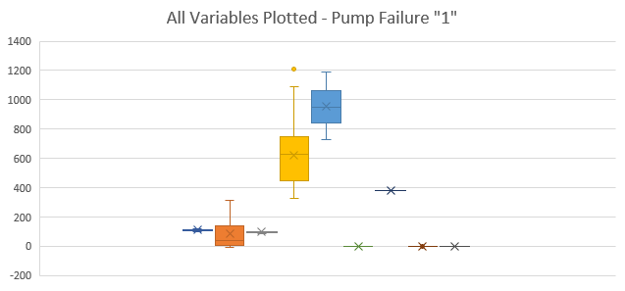
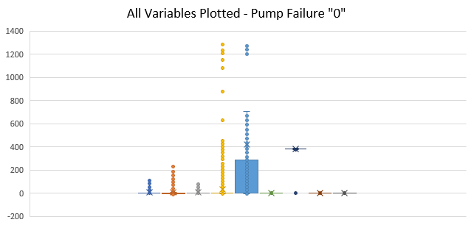
Several indicators have shown a relationship to pump failure. Notice the value change from Non-pump failure to Pump Failure.
Key Insights
Box Plot showing the variables when pump failure does not occur and does occur.
Maximum Daily Pump Torque and Surjek Pump Torque show the highest significance in relation to Pump Failure when comparing both figures.

Slide 6
Several Surjek pump variables that have shown correlation to pump failure, some higher than others.
Key Insights
Correlation methodologies have shown that Surjek Flow Meter 2 Surjek Pump Torque, and Maximum Pump Torque values are the strongest indicators torwards pump failure.
Future maintenance schedules will need to take these values into account.
Chart A
Notes:
Still need tips and assistance with Correlation comparison. Is it just plotting the values from the correlation matrix? Or is it another standard deviation breakdown of all values for Pump Failure 0/1 (No, Yes)?

Slide 7
Predictive model to map out potential Pump Failure Indication. Important to take into Account of Pump Failure Indicators with Predictive Model.
Key Insights
Further analysis of pump failure indicators there are several instances where pump failure may occur due to our predictive model.
Will need to take into account previously shown pump failure variable indicators to match with pump failure instances.
Source: Southern Water Corp Statistical Records

Slide 8
Summary Of Findings
Pump Failure has shown to be correlated with key several indicators that will need to be taken into account when developing future maintenance schedules
Rising Costs to Produce are forecasted to outweigh our actual production Cost to Produce which will need to be factored in when considering our rising Revenue intake.
RECOMMENDATIONS
* Re-evaluate our most cost heavy production centers and develop transistion plan to utilize more efficient water production plants.
* Develop an effective plant maintenance schedule based on pump failure indicators. Potentially develop a new test warning system to further predict future issues.

